Slide 1

0x100 – Introduction to the Introduction
ECED4406 – Computer Security
Dr. Colin O’Flynn
Dalhousie University.

Slide 2
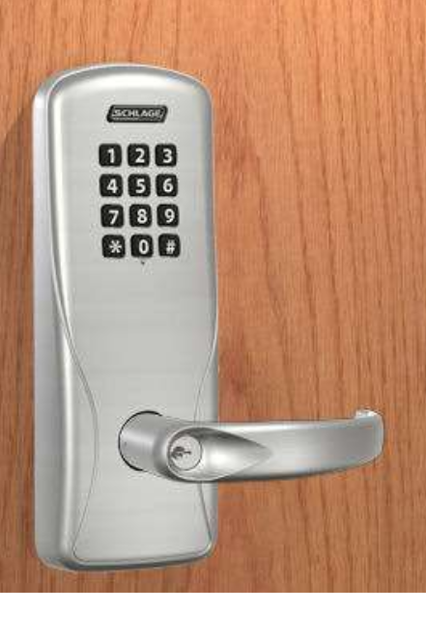
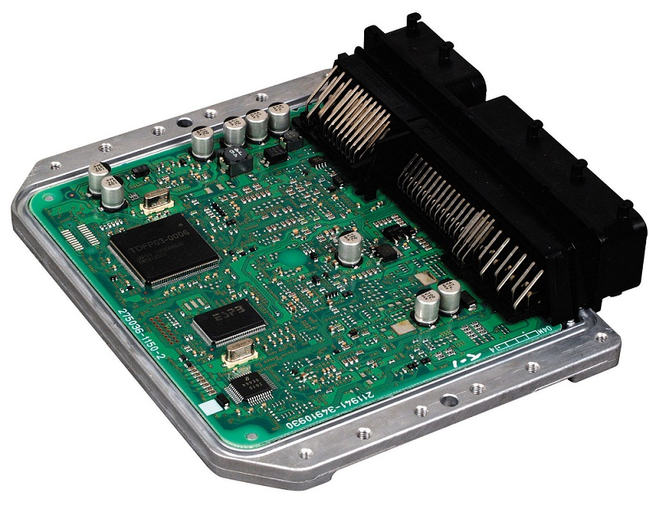
What is this course about?
Embedded system security, such as:
IOT Devices
Automotive Systems
How to secure embedded systems.
What is cryptography?
What is a root of trust, secure boot, etc?
What are security ratings?
How to break embedded systems.
Reverse engineering.
Fuzzing.
Hardware Attacks - Non-invasive.
Hardware Attacks - Invasive

Slide 3
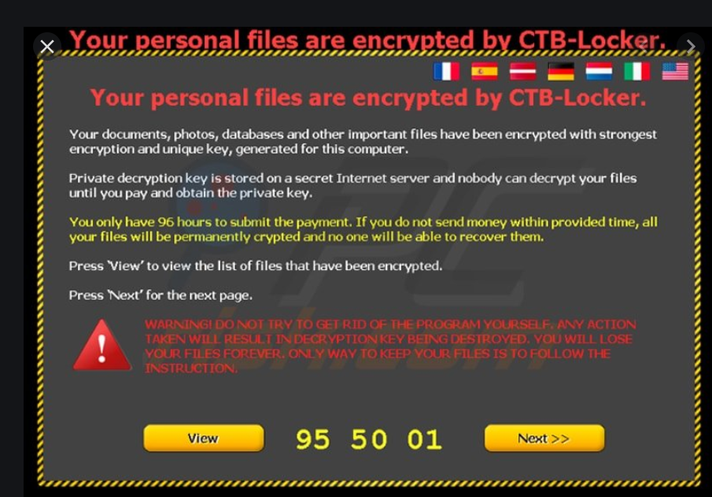

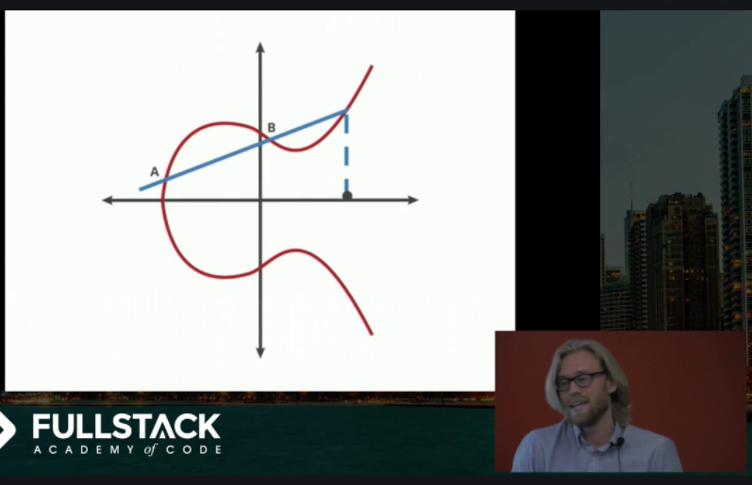
What is this course not about?
Web security & web security protocols.
HTTPS, SSL, etc.
Detail cryptographic algorithm development.
High-level application security (Windows, Linux, etc).

Slide 4
What should you already know?
The following words should mean something to you:
RAM.
ROM.
Stack frame.
Instruction registers.
Matrix multiplication.

Slide 5
Course Lecture Style
Lectures are pre-recorded and posted onto Brightspace.
I will likely mirror them somewhere public to make it easier to view mobile. Please check Brightspace for official links.
Tuesdays @ 1:05PM – 2:25PM we have a “lecture time” (this time here). This will be the chance to ask questions etc.
Thursdays @ 1:05PM – 2:25PM is “reserved course time”.
I will occasionally use this for special topics, additional explanations, etc.
Assume normally this time is reserved for you to watch course lectures so you can keep a regular schedule.
Each lecture is short (5-15 mins), thus one week will have multiple topics covered.

Slide 6
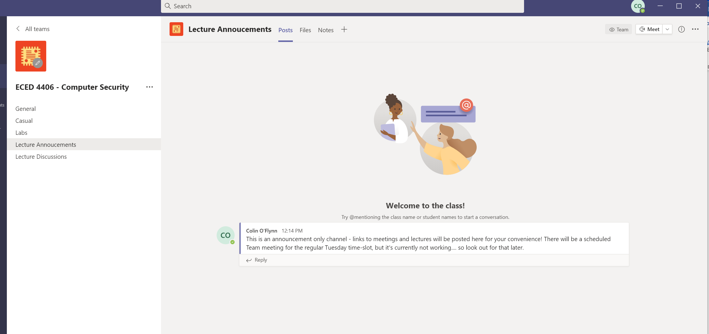
Microsoft Teams Groups

Slide 7
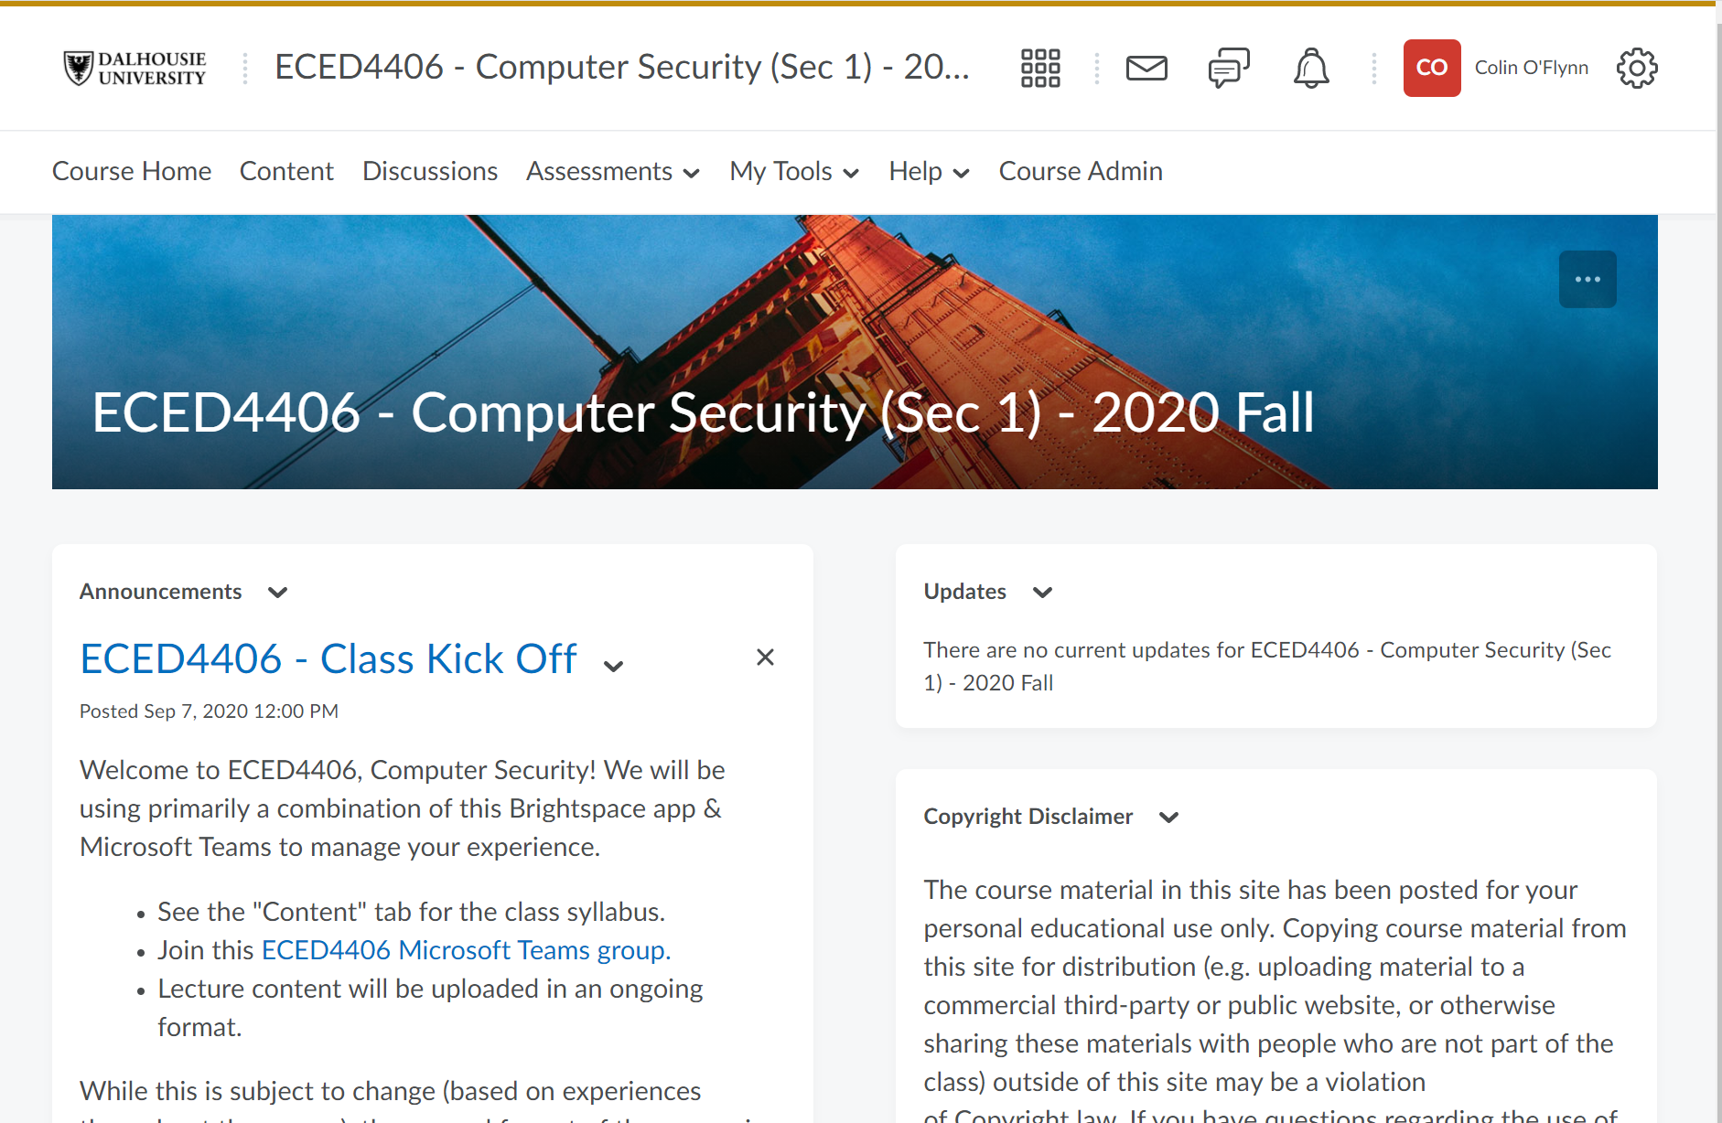
Brightspace

Slide 8
Quizzes
We will start quizzes next week – these cover some of the lecture topics.
They should hopefully reinforce what you’ve learned in the lectures.
They will run through the Brightspace system.

Slide 9
Assignments
Assignments will be throughout the semester
Listed in the syllabus as “Weekly” – likely one every ~2-3 weeks in final version to avoid overloading you.

Slide 10
Labs
We will be attempting some remote labs – they will requires various tools to be installed on your computer.
Linux, Mac, Windows should work here.
Labs will tie in with Assignments & Course Lectures.
Labs are planned to be individual – I’m still discussing how we can keep the group feel alive, but so far it may be easier to run individually.

Slide 11
Course Project
Course project will be a chance to apply some of what you’ve learned in this course.
More details coming next month once you have more background on the material.

Slide 12
Final
There is a 24-hour final (would be ‘take home’, but in this case ‘stay home’) which involves both practical & theoretical aspects.

